Slide 1
Text-to-Speech (TTS) System for OCR-Generated Text
BMI/CEN 598 (Embedded Machine Learning) Project
Sudeeksha Chagarlamudi, Ahlada Ruthwik Chakravarthula, Tejaswini Ashok Walunjkar
Instructor: Hassan Ghasemzadeh
Lab: Embedded Machine Intelligence Lab (EMIL) Web: https://ghasemzadeh.com

Slide 2
Introduction
Reading challenges are common, especially for the visually impaired. Converting text to audio seamlessly is crucial to making information more accessible and inclusive.
Text-to-Speech (TTS) System for OCR-Generated Text transforms printed or digital text into audio, addressing the need for quick and easy access to information.

Slide 3
Hardware Evolution
Initial Hardware Choice: Arduino Nano 33 BLE with OV7675 camera module.
Issue: Insufficient image resolution for ML model training.
Midway Transition: Shifted to ESP32 CAM with OV2640 camera module.
Challenge: RAM limitations hindered model deployment on ESP32.
Optimal Solution: Finalized Raspberry Pi 4 for robust performance.
Features: Raspberry Pi 4 offers ample RAM, processing power, and GPIO support, essential for efficient OCR implementation.

Slide 4
Dataset Dilemmas
Initial Attempt: TextOCR dataset selected for training.
Problem: Inconsistent annotations led to errors during model training.
In-house Synthetic Data: Created synthetic data, but model performance was suboptimal.
Ultimate Dataset: Adopted 'mjsynth' dataset with 9 million images, covering 90k English words.
Benefits: Improved model performance, though training time increased (2 hours per epoch).

Slide 5
Iterative Model Development
Algorithm Training: Utilized synthetic data for initial training iterations.
Challenges Encountered: Overcame dataset annotation issues and model performance drawbacks through iterative training.
Optimization Strategies: Fine-tuned the model to achieve real-time OCR on Raspberry Pi 4.

Slide 6
Results
Performance Metrics: Achieved OCR accuracy rate of 74% with 'mjsynth' dataset on Raspberry Pi 4.
Real-time Demonstration: Live showcase of text-to-audio conversion on Raspberry Pi 4, reinforcing practicality.

Slide 7
Limitations and Future Directions
Sensitivity to Lighting Conditions: Variations impact accuracy under different illumination levels.
Font Style Dependency: Struggles with fonts significantly different from training set, affecting diverse text transcriptions.
Complex Layout Challenges: Inability to handle text in complex layouts, such as overlapping or distorted text.
Inconsistent Line-by-Line Reading: Lacks consistent line-by-line reading, leading to occasional disruptions in text-to-speech output.

Slide 8
Future Directions
User Interface Development: Create an intuitive user interface for easy navigation and customization, enhancing the overall user experience.
Multilingual Support: Expand the OCR solution to support multiple languages, fostering inclusivity for a diverse user base.
Continuous Model Training: Implement a system for ongoing model training to adapt to evolving language patterns and improve accuracy over time.

Slide 9
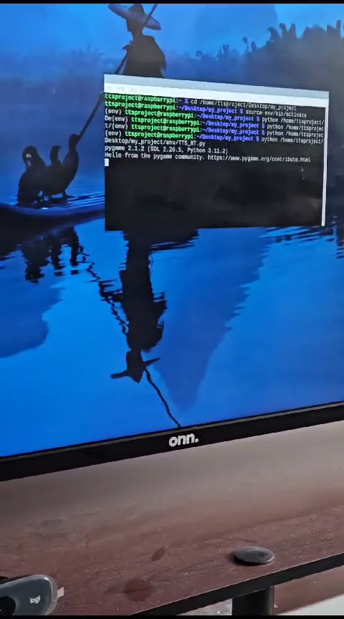
Demo

Slide 10
Team Members:
Hardware Exploration ( Problem Solving Feature Assessment): Ruthwik
Dataset Evaluation( Annotation Resolution, Performance Optimization): Tejaswini
Model Training Strategies (Challenges Mitigation): Sudeeksha
Real-time OCR Implementation: Ruthwik, Sudeeksha, Tejaswini

Slide 11

GO DEVILS!

